Slide 1
Linear layer
2021-04-16
4th grade
Jaeho Jeon

Slide 2
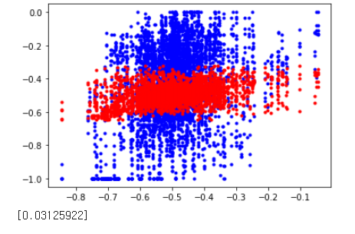
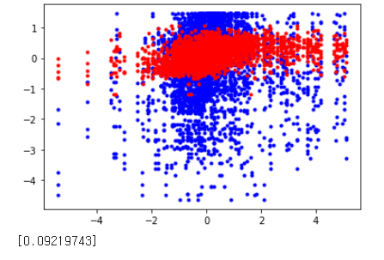
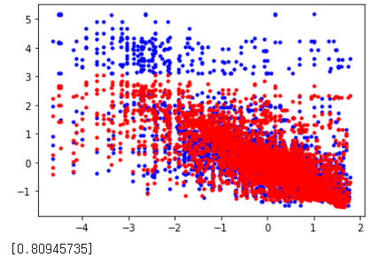
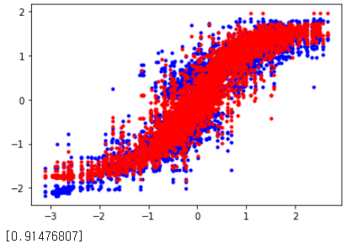
Training 4000 test 1116
Pan_loop
Tilt_loop
train
test
Trans_loop
Rotate_loop

Slide 3
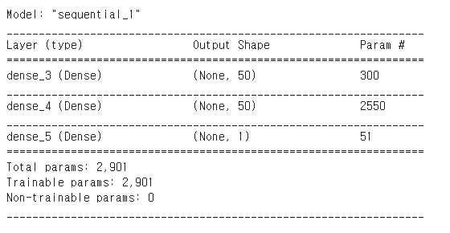
Input size = 5, standardization
Output = 1
min-max norm
1
X
5
Norm_input
5
X
10
Dense1
10
X
1
Dense
2
input
output
1x1
predic
loss
tanh
1x1
Norm_output
kernel_initializer=‘glolat normal'
bias_initializer='zeros'
activation='tanh'
model.compile(optimizer=sgd_optimizer, loss='mse')
Epoch = 50, lr = 1*e-6

Slide 4
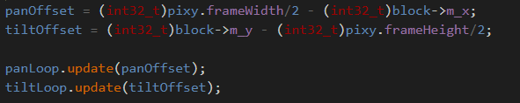
Pan tilt
Pan tilt

Slide 5
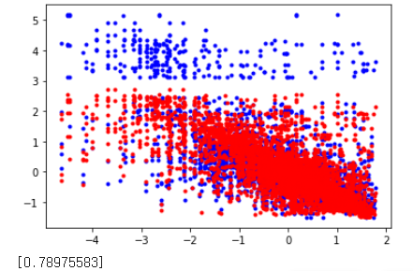
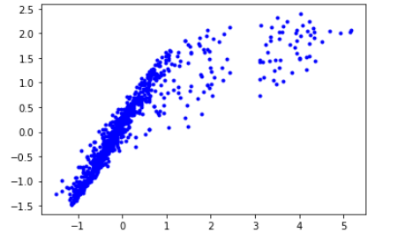
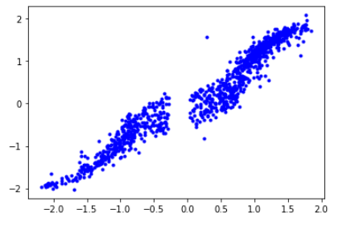
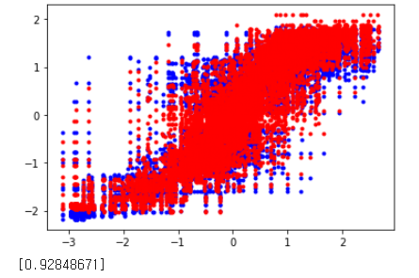
프로젝트 제목
Drop out + boxsize 10
Trans_loop
R-square : 0.8094 ->0.7897
train
TransLoop.m_command
predict
test
Trans_loop offset
real
Rotate_loop
R-square : 0.9147 -> 0.9284
RotateLoop.m_command
predict
rotate_loop offset
real

Slide 6
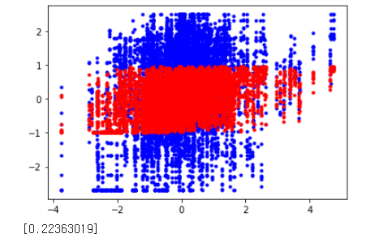
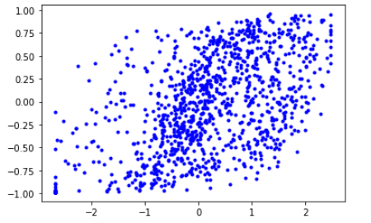
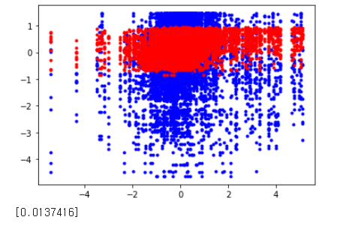
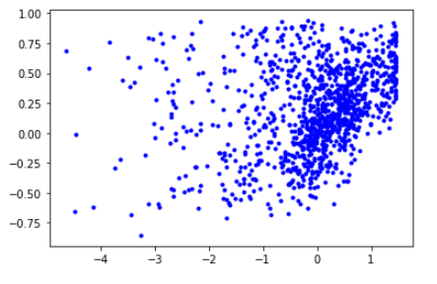
프로젝트 제목
Drop out + boxsize 10
Pan_loop
R-square : 0.0312 -> 0.2236
train
panLoop.m_command
predict
test
Pan_loop offset
real
Tilt_loop
R-square : 0.0921 -> 0.0137
tiltLoop.m_command
predict
tilt_loop offset
real

Slide 7
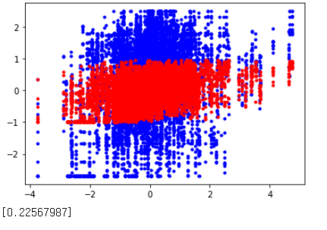
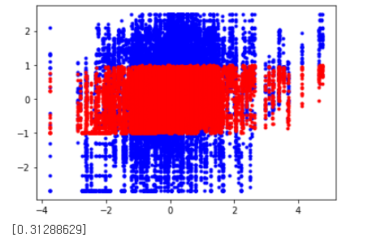
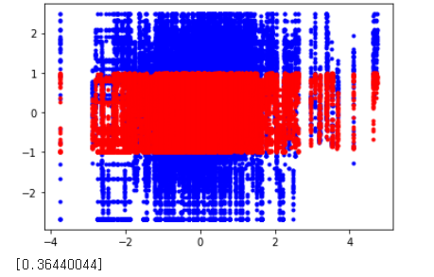
프로젝트 제목
Pan_Loop data
Box size : 5
Box size : 10
Box size : 15
Box size : 20

Slide 8
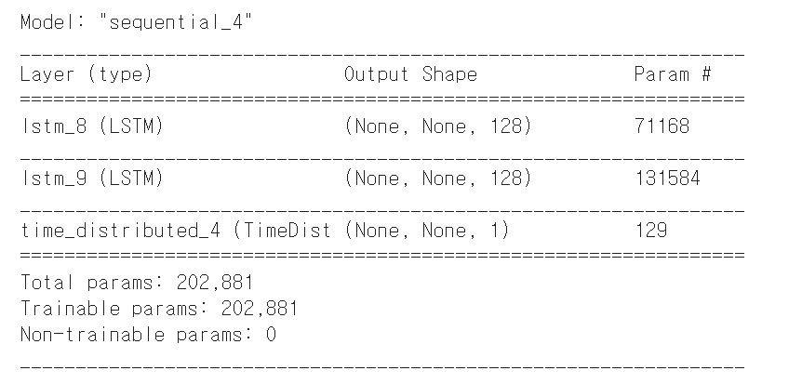
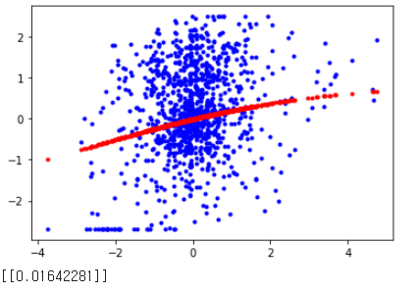
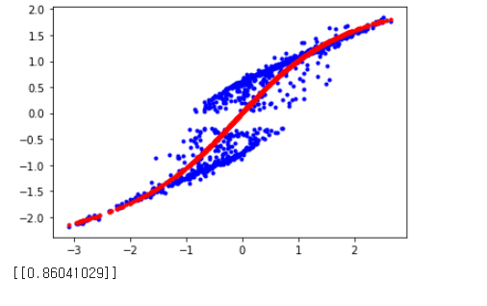
프로젝트 제목
LSTM, Many to many, 2 layer
Pan_loop
train
test
Rotate_loop

Slide 9
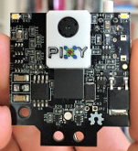
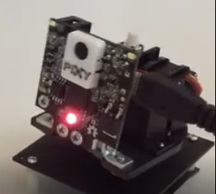
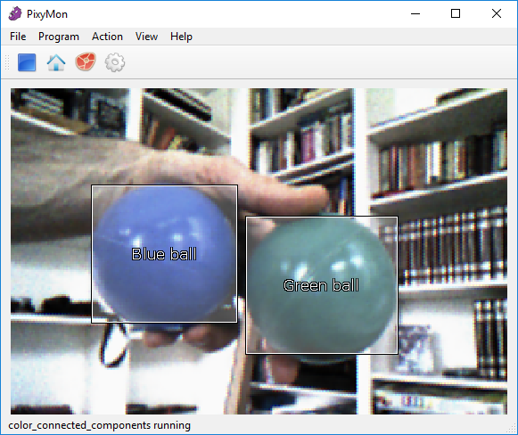
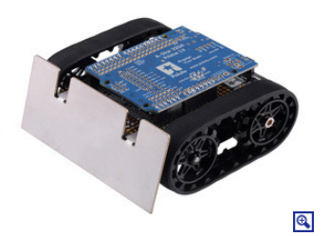
relation
panOffset(x axis)
Pan-Loop
panLoop.m_command
tiltOffset(y axis)
Tilt-Loop
tiltLoop.m_command
rotateOffset(left or right)
transOffset(height)
Rotate-Loop
rotateLoop.m_command
panOffset = (int32_t)pixy.frameWidth/2 - (int32_t)block->m_x;
transLoop.m_command
tiltOffset = (int32_t)block->m_y - (int32_t)pixy.frameHeight/2;
Trans-Loop
rotateOffset = panOffset + panLoop.m_command - CENTER_POS;
transOffset = tiltOffset + tiltLoop.m_command + CENTER_POS
left = -rotateLoop.m_command + translateLoop.m_command;
right = rotateLoop.m_command + translateLoop.m_command

